Slide 1
Technical insight into the Waste-to-Energy initiative in Lao PDR
Workshop on
Waste-to-energy, Industrial waste reuse and prevention solutions
Asia-Pacific Climate Week
Singapore, 12 July 2018
Brahmanand Mohanty, Ph.D.

Slide 2
Industrial waste-to-energy initiative in Lao PDR
Agricultural and agro-industrial waste
Rural industries and households
Project Objective: To reduce GHG emission in Lao PDR’s industries by promoting the production and usage of high-quality solid biofuel for thermal energy applications
Agri-residue resources in Laos can theoretically meet 238% of the primary energy use.
ADB sponsored study (2013)
Introduction of technologies, economic models and policies for:
Conversion of traditional agricultural and agro-industrial waste into modern biomass energy
Efficient utilization of modern biomass energy to avoid the import of fossil fuels, improve human health, reduce deforestation and lower greenhouse gas emissions

Slide 3
Industrial waste-to-energy initiative in Lao PDR
Situation analysis:
Traditional fuels (wood and agricultural waste):
Major source of energy, often not correctly priced, not easy to transport and use
Crude technologies for combustion:
Inefficient fuel use, low-quality product, poor air quality, affecting human health & the environment
Over-exploitation of natural resources:
Deforestation
Some industries shifting to fossil fuels:
Improve product quality and the environment but increase import dependence
Barriers / challenges:
Lack of awareness and exposure to suitable technologies and practices
Limited expertise to adopt clean technology solutions
Lack of supportive policy framework for efficient use of local energy resources
Lack of tools and mechanisms to develop bankable proposals

Slide 4
Industrial waste-to-energy initiative in Lao PDR
UNIDO-GEF’s response to overcome the challenges:
Propose solutions to
Convert wood and agro-industrial waste into modern energy sources (pellets) that can be easily stored, transported and used efficiently in suitably designed burners, stoves and boilers
Such solutions allow small and medium industries to
Reduce dependence on fossil fuels
Avoid over-exploiting traditional energy sources and reduce human drudgery
Carry out efficient production and improve product quality
Improve the air quality in the work place and contribute to better human health
Mobilize expertise to strengthen capacities of different stakeholders (producers, users, technology providers, banks and policy makers)

Slide 5
Industrial waste-to-energy initiative in Lao PDR
The above technologies are quite common in neighboring Thailand and Vietnam but not yet in Laos:
Small country with low population dispersed over a fairly large territory
Easy access to traditional fuel at very low cost and averse to high first-cost
Low level of industrial development and lack of support for research and innovation
SMIs have poor knowledge of market to sell better quality product at higher price
UNIDO-GEF’s role:
Initiate technology demonstration through technology transfer from neighboring countries, with involvement of local stakeholders, including R&D entities
Hold sensitization seminars to showcase the technology and highlight the economic, social (job creation, gender mainstreaming) and environmental co-benefits
Support the government in creating a Biomass Technology Information and Learning Centre (BTILC) for strengthening institutional and human capacity
Provide feedback to policy makers on suitable regulatory and incentive measures

Slide 6
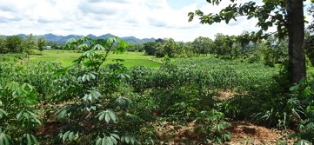
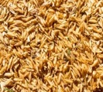
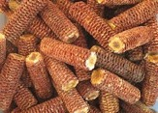
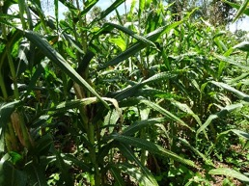
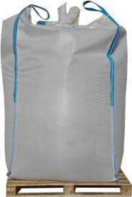
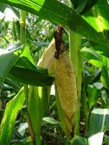
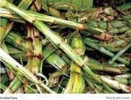
From agro-waste to useful energy: value chain
Agriculture and Wood Sources
Pellet production plant
Customers
Agro/Wood factories
Emphasis on:
Technology support, capacity building and inclusive development
South-South cooperation
Ensure suitability of technology to the context of the country

Slide 7
Mapping of resources (waste from agro-industries)
Corn cob
Bagasse
Rice Husk
Phongsaly
Phongsaly
Phongsaly
Laung
namtha
Laung
namtha
Laung
namtha
Oudomxay
Luangphabang
Oudomxay
Luangphabang
Oudomxay
Luang
phabang
Huaphan
Bokeo
Huaphan
Bokeo
Huaphan
Bokeo
Xayaboury
Xiengkhuang
Xayaboury
Xiengkhuang
Xayaboury
Xiengkhuang
Vientiane
Xaysomboun
Vientiane
Xaysomboun
Vientiane
Xaysom
boun
Bolikhamxay
Bolikhamxay
Bolikhamxay
Vientiane Capital
Khammuane
Vientiane Capital
Khammuane
Vientiane Capital
Khammuane
Savannakhet
Savannakhet
Savannakhet
>80,000 ton per year
Saravan
>150,000 ton per year
Saravan
>150,000 ton per year
Saravan
60,001-80,000 ton per year
Sekong
100,001-150,000 ton per year
Sekong
100,001-150,000 ton per year
Sekong
20,001-60,000 ton per year
Champasak
50,001-100,000 ton per year
Champasak
Attapeu
50,001-100,000 ton per year
Champasak
< 20,000 ton per year
Attapeu
< 50,000 ton per year
Attapeu
< 50,000 ton per year

Slide 8
Selection of ideal site and sizing of pellet plant
Vientiane
Source of agro-industrial waste
>500 Ton per month
100-400 Ton per month
< 100 Ton per month
Factories using traditional fuel inefficiently
Salt factory
Objective: Minimize transportation while closing the loop (circular economy)

Slide 9
Bio-Pellet production technologies

Slide 10
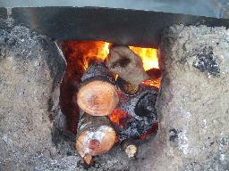
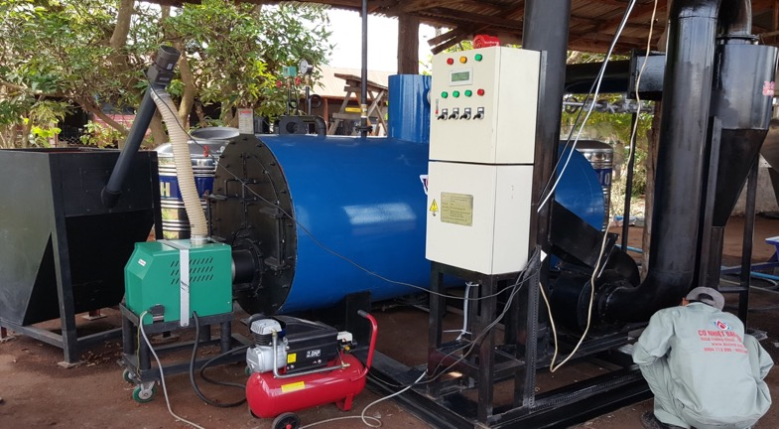
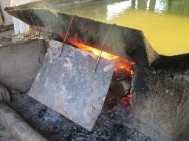
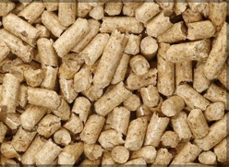
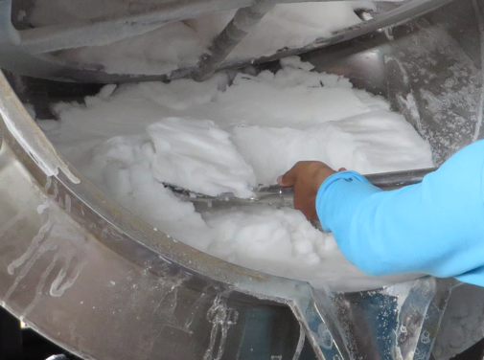
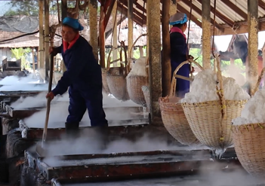
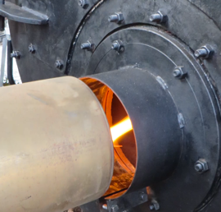
Bio-Pellet consumption technologies (1)
Screw feeder
Flue gas stack
Boiler control
Fuel hopper
Burner control
Burner
Air compressor

Slide 11
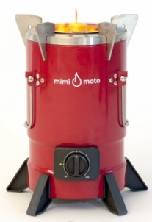
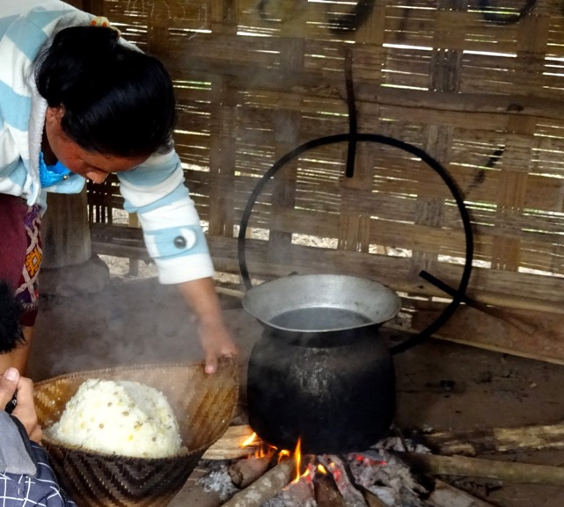
Bio-Pellet consumption technologies (2)
This is in synergy with the World Bank initiative addressing a number of Sustainable Development Goals, including good health and well-being, gender equality, climate action

Slide 12
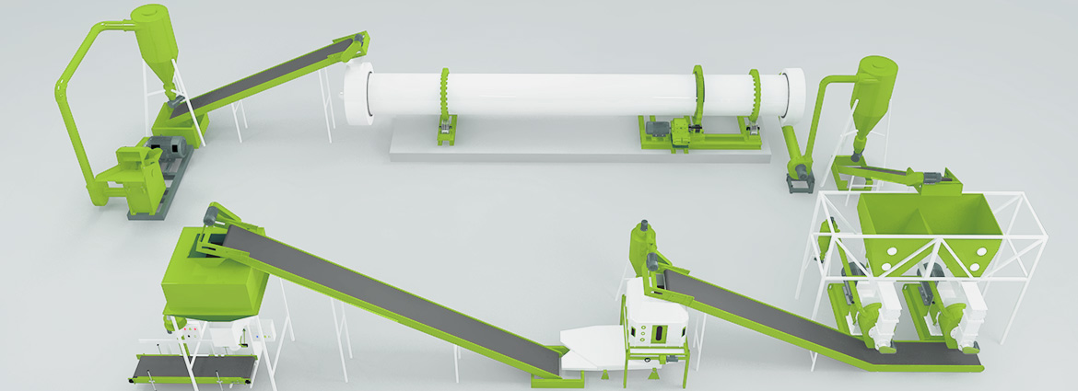
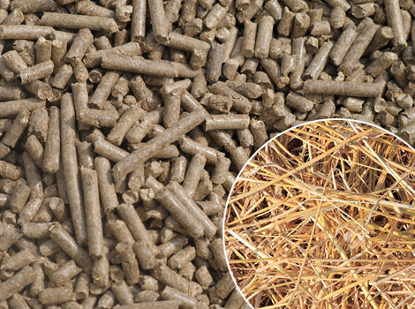
Co-benefits from a typical 2 t/h pellet plant
Create 20 new jobs
Avoid 10,000 tons of coal/year
Provide clean cooking for 18,000 families
Improve health of 25,000 women & children
Reduce 14,500 tons/year of GHG emissions
Protect
470 ha of forest land

Slide 13
Lessons learned to replicate best practices
Low-density agro-industrial residue has a huge potential to be used as modern energy source in less developed countries
Government policy should favor closing the loop at the local level
Technological solutions should be dictated by inclusive industrial development goals (economic, social, energy security, environment)
South-South cooperation can generally make technology transfer more easily acceptable (e.g. replication in other LDCs like Cambodia)
Awareness raising and capacity enhancement should be a constant preoccupation of national decision-makers

Slide 14
Thank you for your attention

