Slide 1

MULTIPLE BENEFITS PATHWAYS APPROACH – EXPERIENCE FROM BANGLADESH
Dr. Tanvir Ahmed
Bangladesh Univ. of Engineering and Technology (BUET)
Asia Pacific Climate Week, 10-13 July, 2018, Singapore
Session: WS 12: Maximizing Benefits in Achieving Global Climate Goals

Slide 2
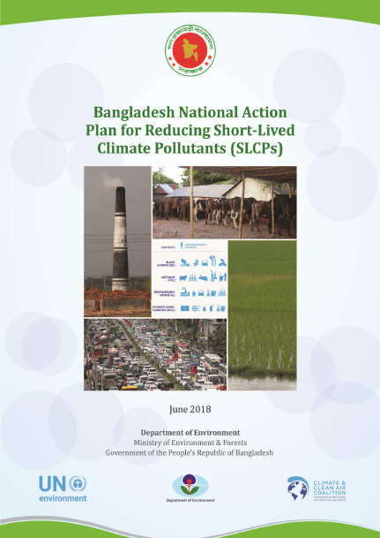
The National Plan for Action on SLCP
The current major sources of black carbon and methane emissions, emission reduction potential in different sectors in Bangladesh
A package of priority measures to reduce SLCPs and achieve simultaneously human health and crop yield benefits through improved air pollution, and a reduction in Bangladesh’s contribution to climate change in the near term.
Maximum Pathway Practice - Bangladesh Dr. Tanvir Ahmed

Slide 3
Black Carbon and Methane Emissions
Maximum Pathway Practice - Bangladesh Dr. Tanvir Ahmed

Slide 4
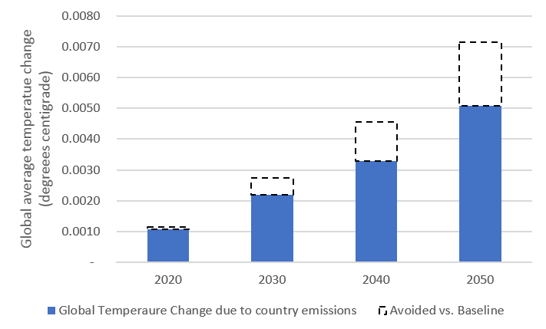
Climate Benefits of SLCP Measures
SLCPs | Source Sector | Measure
Black Carbon | Residential | Replacing traditional biomass cookstoves with improved biomass cookstoves
 | Waste | Reduce open burning of waste
 | Industry | Replace traditional brick kilns with improved brick kilns
 | Industry | Replace traditional rice parboiling units with improved units
 | Agriculture | Reduce crop residue burning in fields
 | Transport | Eliminate high emitting vehicles
Methane | Agriculture (Livestock) | Reduce methane emissions from livestock enteric fermentation
 | Agriculture (Livestock) | Reduce methane emissions from livestock manure management
 | Waste | Promote landfill CH₄ gas collection with combustion or utilization
 | Waste | Reduce methane emissions from domestic wastewater
 | Agriculture (Rice cultivation) | Alternate wetting and drying (AWD) for rice cultivation
 | Energy | Fugitive emission from natural gas transmission and distribution
The reduction of SLCPs in Bangladesh that would result from the implementation of these measures could reduce global temperature about 0.0021 Degree Centigrade by 2050 (24% of Bangladesh's contribution).
Maximum Pathway Practice - Bangladesh Dr. Tanvir Ahmed

Slide 5
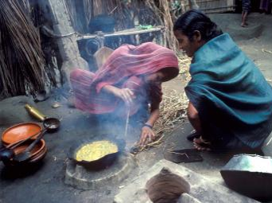
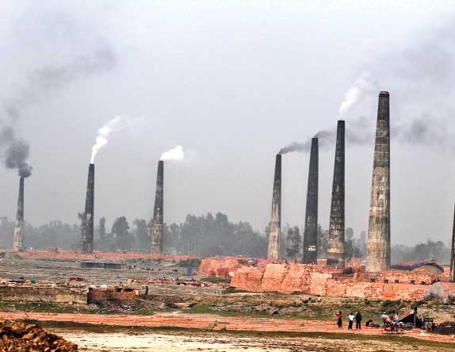
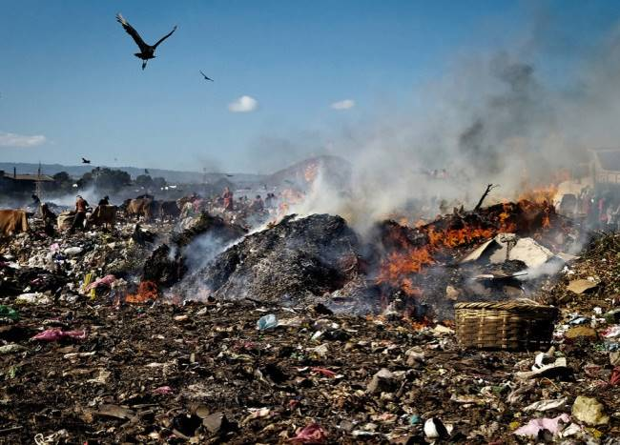
SLCP Measures can also have significant health benefits
Traditional cookstoves
Traditional brick kilns
Open burning of MSW
Major sources of black carbon which is a fraction of fine particulate matter, a criteria air pollutant.
Maximum Pathway Practice - Bangladesh Dr. Tanvir Ahmed

Slide 6
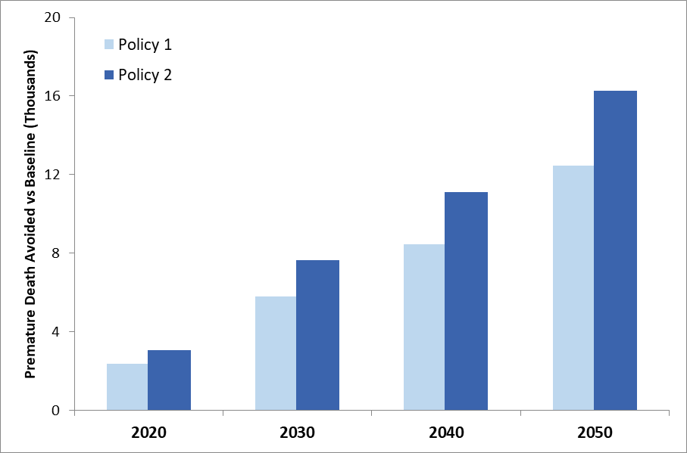
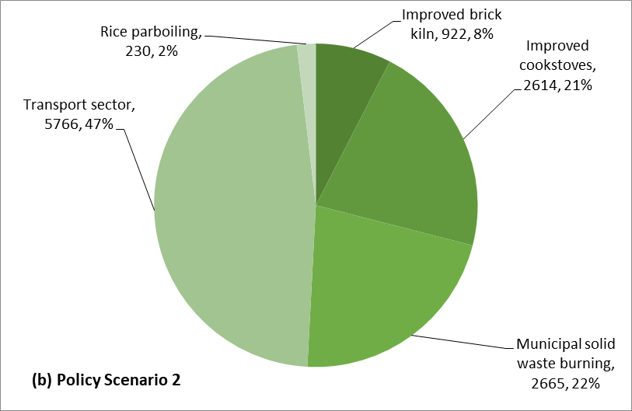
SLCP Measures can also have significant health benefits
SLCP measures can achieve upto 16,274 premature deaths avoided per year in 2050.
BC measures has the largest share on these benefits.
Maximum Pathway Practice - Bangladesh Dr. Tanvir Ahmed

Slide 7
Intended NDC and SLCP Measures
Source Sector | Measure | Scenario
Energy | Energy Efficiency (Energy Efficiency & Conservation Master Plan target) | NDC (Existing)
Power Generation | Renewable Energy
Industry | Improved Brick Kilns
Residential | Improved biomass cookstoves
Power Generation | Supercritical coal power plants | NDC (Additional)
Transport | Road transport fuel efficiency
Power Generation | Wind and Solar
Residential | Improved biomass stoves and LPG use for cooking | NDC (Possible)
Commercial and Public Services | Commercial Energy Consumption
Agriculture | Alternate Wetting and Drying of Rice paddies
Waste | Landfill gas capture
Waste | Organic waste diverted from landfill to composting
Industry | Efficient rice parboiling units | SLCP Action
Agriculture | Reduce open burning of crop residues
Transport | Adopt Euro Standards in road transport
Transport | CNG conversion
Agriculture | Livestock enteric fermentation
Waste | Domestic Wastewater
Natural Gas | Reduce leakage from natural gas processing and distribution
Agriculture | Reduction of CH₄ emissions from livestock, through anaerobic digestion of manure from cattle and poultry
Maximum Pathway Practice - Bangladesh Dr. Tanvir Ahmed

Slide 8
NDC measures also contribute to mitigation of air pollutant emissions (BC and NOx)
NOx
Maximum Pathway Practice - Bangladesh Dr. Tanvir Ahmed

Slide 9
SLCP measure also contribute to meaningful mitigation of GHGs (CO₂ and Methane)
CO₂
Maximum Pathway Practice - Bangladesh Dr. Tanvir Ahmed

Slide 10
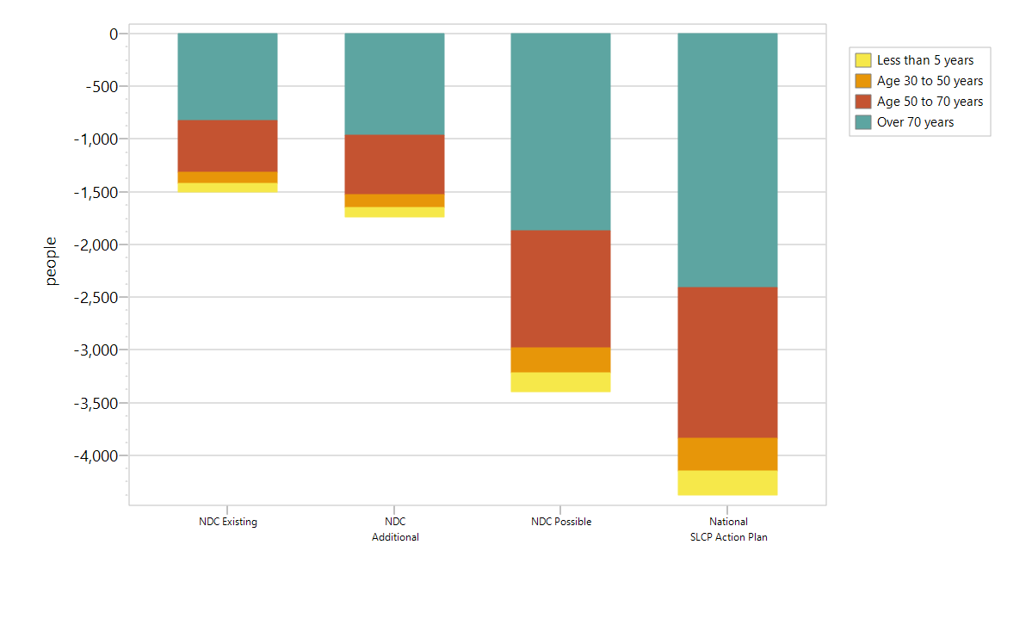
Climate and Health Benefits under different Scenarios
NDC measures provide a large climate benefits and significant health and agricultural benefits.
Climate
Adding the SLCP measures improves the health benefits and further reduces Bangladesh's contribution to global temperature increase
Premature Deaths avoided vs BAU
Maximum Pathway Practice - Bangladesh Dr. Tanvir Ahmed

Slide 11
Why the Multiple Benefits Approach useful?
We can emphasize the benefits of taking certain actions and how these contribute to goals such as positive health outcomes in Bangladesh (the benefit of death avoided from air pollution is justified enough to warrant actions)
An alternate justification to NDC actions (development benefit of climate actions)
Practical way to engage the general public.
Can help prioritize different mitigation measures
Can potentially promote regional cooperation (regional common good)
the Pathways analysis allows to integrate plans, strategies and policies that were designed for different purposes to see what the overall effect of these different plans are on different impacts
Maximum Pathway Practice - Bangladesh Dr. Tanvir Ahmed

