Slide 1


Workshop on South-South and Technological Cooperation for Climate Action and Sustainable Development
Asia Pacific Climate Week, Resort World Sentosa, Singapore
13 July 2018
Experiences, opportunities and challenges of South-South and Triangular Cooperation in the Asia Pacific region:
Thailand’s experiences
Dr.Surachai Sathitkunarat
Assistant Secretary General & Thailand NDE Focal Point
National Science Technology and Innovation Policy Office, Ministry of Science and Technology, Thailand

Slide 2

UNFCCC - Major milestones on technology
2010 – UNFCCC Technology Mechanism: Mechanism to enhance action on technology development and transfer
Technology Executive Committee (TEC)
  Policy arm
  20 member expert committee
Climate Technology Centre and Network (CTCN)
  Implementation arm
  Centre hosted by UNEP
  Network of +20 regional organizations
Source: Wanna Tanunchaiwatana (2015)

Slide 3
Climate Technology Center and Network (CTCN)
Conference of Parties (COP) and CTCN Advisory Board guide the work of the CTCN
CTCN operations are conducted through:
The CTCN Secretariat hosted by UNEP and UNIDO
CTCN Consortium: 11 independent, regional and global organizations with expertise in a variety of climate technology sectors
An international network of academic, multilateral, NGO and private sector institutions
National Designated Entities (NDEs): national CTCN focal points selected by each country to coordinate and submit technical assistance requests to the CTCN
Source: Jukka Uosukainen (2015)

Slide 4



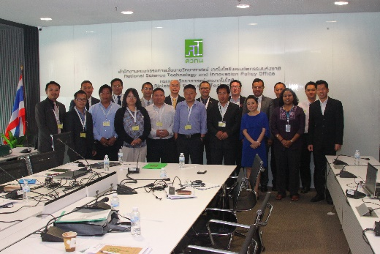
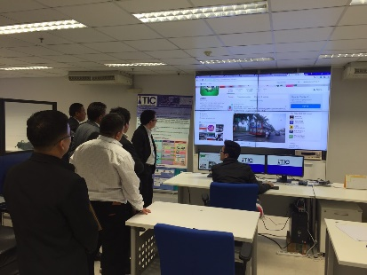
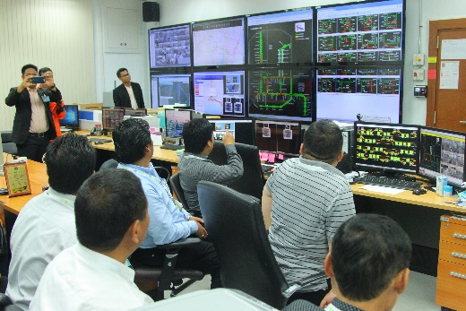
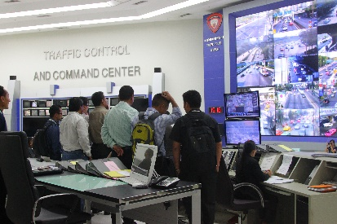
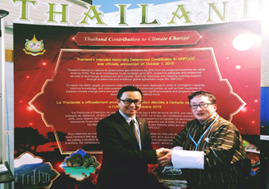
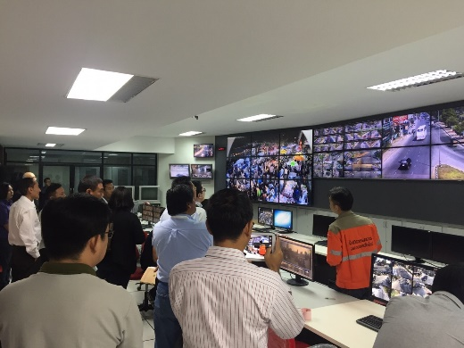
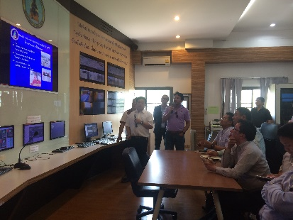
Reducing GHG Emissions from Transport by Improving Public Transport Systems through Capacity Building and Use of Technology
Activity 1 - Training and Field Visits
15 – 19 February 2016, Bangkok and Chiang Mai, Thailand
The 1st south-south collaboration between NDEs supported by the CTCN
To provide the Bhutan’s participants with an overview of the Thai experiences on intelligent transport systems (ITS) and public transport systems by Thai experts

Slide 5
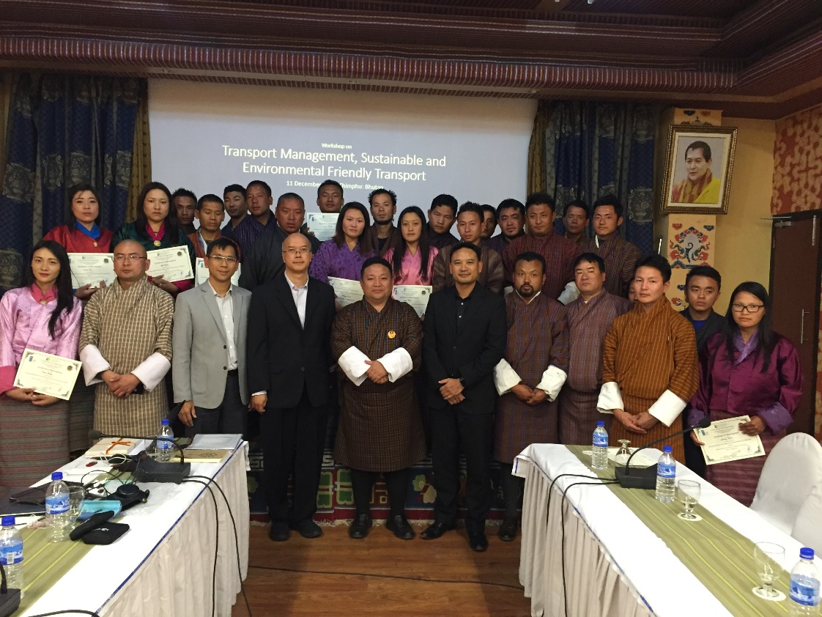
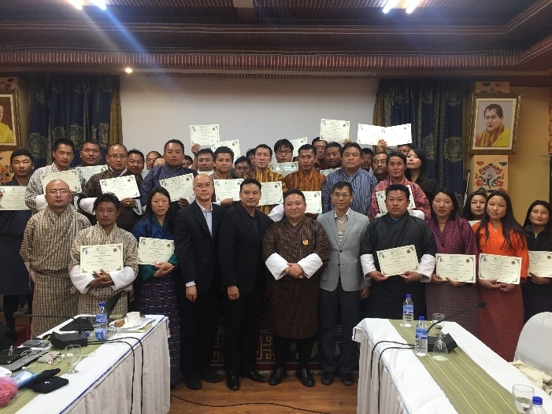
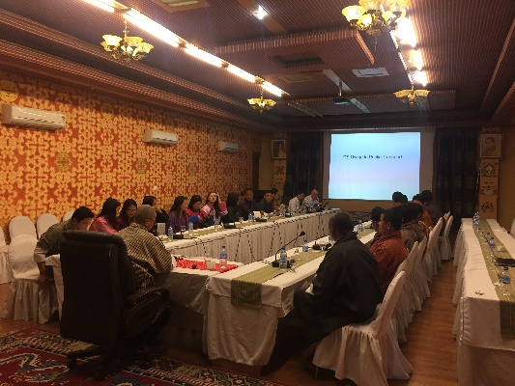
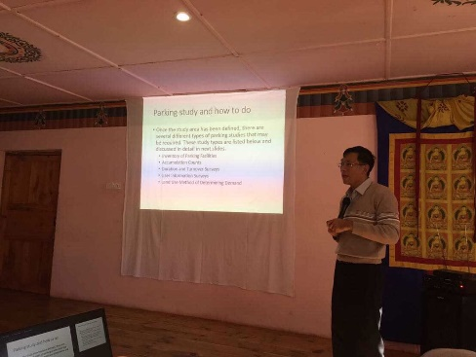
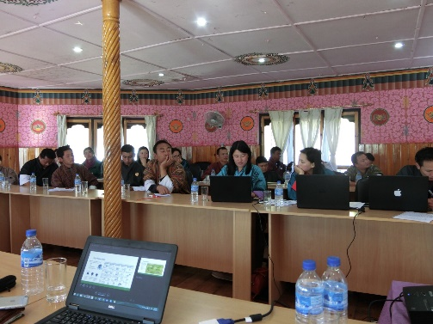
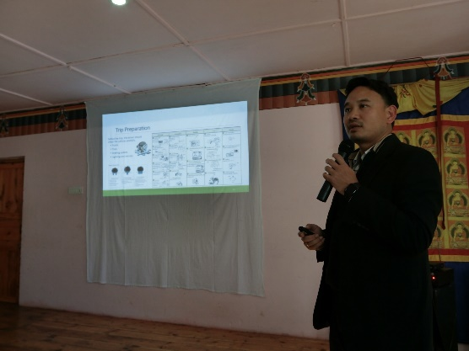
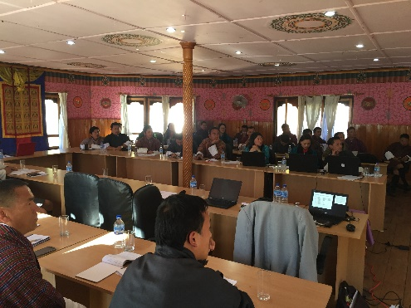
Reducing GHG Emissions from Transport by Improving Public Transport Systems through Capacity Building and Use of Technology
Activity 2 - Workshop on sustainable and environmental friendly transport
10 – 13 December 2016, Thimphu, Bhutan

Slide 6
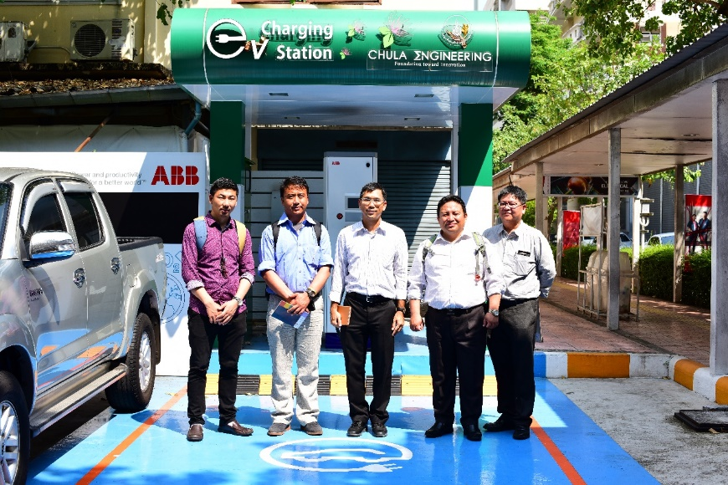
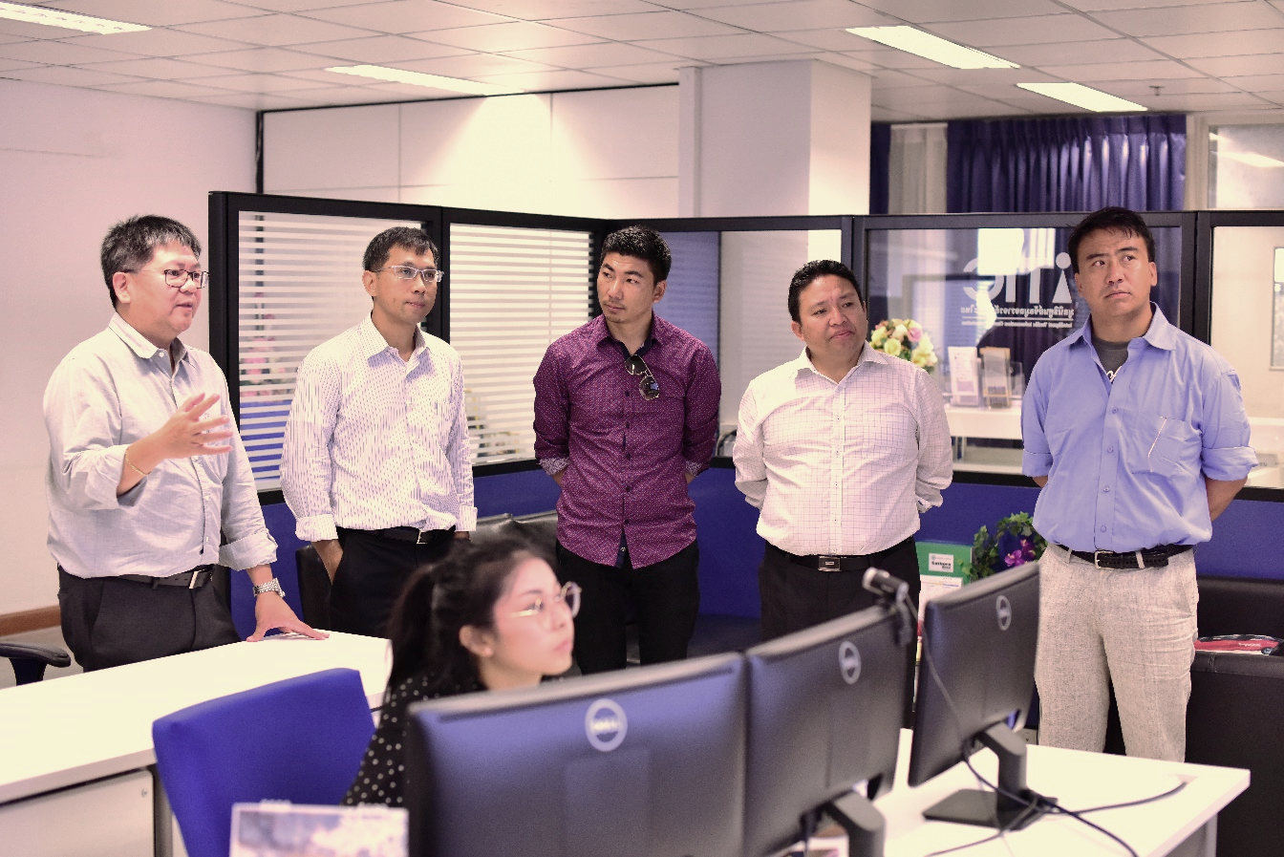
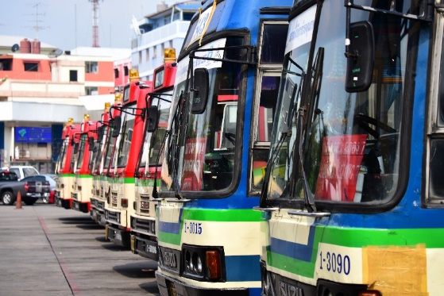
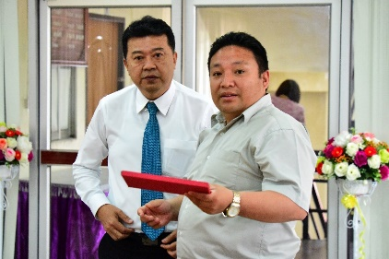
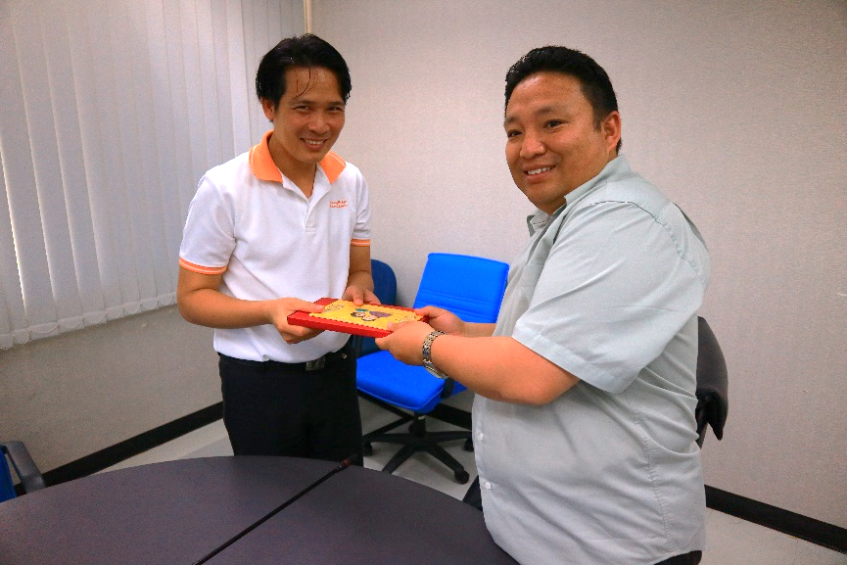
Reducing GHG Emissions from Transport by Improving Public Transport Systems through Capacity Building and Use of Technology
Activity 3 - Study tour: Bangkok’s mass transit management systems and infrastructure
12-16 March 2018, Bangkok, Thailand

Slide 7

For more information, please contact
THAILAND NDE Focal Point;
Dr. Surachai Sathitkunarat
Assistant Secretary General
National Science Technology and Innovation Policy Office (STI), Bangkok, Thailand
E-mail : surachai@sti.or.th
THANK YOU
Thailand NDE
National Science Technology and Innovation Policy Office (STI)
319 Chamchuri Square Building,
14th Fl., Phayathai Rd., Patumwan Bangkok, 10330 Thailand
E-mail : ThailandNDE@sti.or.th
Website: www.sti.or.th
Tel: + 66 2160 5432 to 37
Fax: +66 2160 5438

