Slide 1
Indonesia’s South-South AND TRIANGULAR cooperation experiences in the context of ASEAN
DR. NUR MASRIPATIN
Senior Advisor to the minister of environment and forestry/ARKN-FCC Coordinator 2008 - 2013
Indonesia
workshop on South-South and Technological Cooperation for Climate Action and Sustainable Development
UNOSSC – UNFCCC, APCW, Singapore, 13 July 2018

Slide 2
Indonesia’s policy on south-south and triangular cooperation (SSTC)
From 2000 - 2013, Indonesia has contributed approximately USD 49,8 Million (national and international sources) to SSTC in Asia-Pacific region and beyond, focusing on the following sectors :
Agriculture
Scholarships
Disaster risk reduction
Maternal and Child Health
Infrastructure
Women Empowerment.
Climate change is among priority areas which came later than the above priority areas.
Blue print and grand design for SSTC has been developed for 2011 – 2025 period (stage 1 : stronger coordination within revitalized institutional framework/2011-2014; stage 2: new emerging partner innovative SSTC for development/2015-2019; stage 3 : stronger partnership within innovative and inclusive SSTC/2010 – 2015).
(source : MoFA )

Slide 3
FOCUS AREAS OF SSTC IN FOREST AND CLIMATE CHANGE IN ASEAN : lessons from ARKN-FCC
POLICY
Strengthening negotiation capacity of ASEAN member states in UNFCCC and other related fora
Development of common position in FCC (particularly REDD+) in UNFCCC negotiation
METHO-
DOLOGY
Development of guidance for FREL/FRL and MRV for REDD+ to assist AMS in developing FREL/FRL and MRV system/mechanism
Expert dialogue on methodological aspects for REDD+ and FCC in general
CAPACITY BUILDING
Training workshops on methodological aspects (combined activities with Focus Area 2 : methodology)
Workshops on REDD+ architecture (FREL, MRV, institutional arrangement, safeguards, finance)
COMMUNICA-
TION AND SHARING BEST PRACTICES
Development of Decision Support Tools for addressing drivers of deforestation and forest degradation in ASEAN region
Study visits (f.e. to countries implementing forest carbon market at the national level (Australia, New Zealand)
Separate/combined activities with other focus areas (among AMS)
Participation of ARKN-FCC in relevant fora/events to communicate ARKN-FCC works and the progress
ARKN-FCC and AMS hosting events in the margin of COP-UNFCCC.
Note : ARKN-FCC : ASEAN Regional Knowledge Network on Forest and Climate Change (2008-2013),
has changed to ASEAN Working Group on Forest and Climate Change (AWG-FCC)since 2014

Slide 4
FUNDING SOURCES AND APPROACHES : SSTC under ARKN-FCC
Brunai Darussalam
Cambodia
Lao PDR
Malaysia
Myanmar
Philippines
Singapore
Thailand
Vietnam
Indonesia
ASEAN Bilateral Partners
(Germany, Australia)
Indonesia as the ARKN-FCC
Chair/Coordinator
National budget
Bilateral - Indonesia
3. Multilateral – Indonesia
(e.g. FCPF REDD+
Readiness)
ASEAN
Secretariat
10
ASEAN member states
(AMS)
Expanded capacity building Programme by LEAF-USAID (from some countries to all AMS, in coordination with Indonesia as the ARKN-FCC Chair/Coordinator)

Slide 5
Key factors for success
SSTC is one of the approaches of Indonesia’s international cooperation policies, giving more flexibility in the use of financial resources both from national and international sources.
Common understanding on the important roles of forests in ASEAN region in climate change mitigation/adaptation and in economic development as well as for people’s livelihood and other environmental protection.
Commitment and support of ASEAN Leaders, in this case ASOF and respective NFPs for UNFCCC, especially in endorsing the common position for UNFCCC negotiation on REDD+.
Working modalities which ensure transparency, inclusiveness, acknowledge and respect the diversity of the AMS in various aspects, and focus on commonality for working together.

Slide 6
CHALLENGES AND Opportunities to sustainably up scaled SSCTC and necessary enabling environment
The main challenge is the gaps between resource needed and the available resource to implement agreed programmes and activities;
Opportunities are emerging, including enhanced public-private partnership, however, capacity to develop such partnership and to access finance from various sources has yet to be enhanced;
Transparency, inclusiveness, enhanced public-private-people partnership are among enabling environment necessary for upscaling SSTC in a sustainable manner.

Slide 7
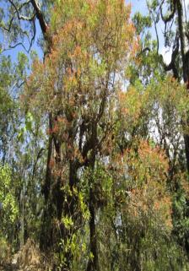
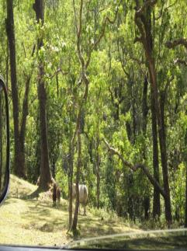
nurmasripatin@gmail.com
Thankyou
passion & integrity

