Slide 1
New Zealand’s triangular climate technology cooperation
a Pacific perspective

Slide 2
Triangular cooperation
Developing countries are key actors in investment & development
Countries lead their own development
Leverages financial and technical support
Allows partners to play to their respective strengths

Slide 3
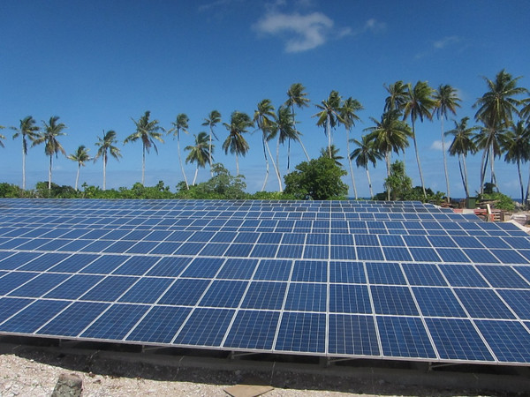
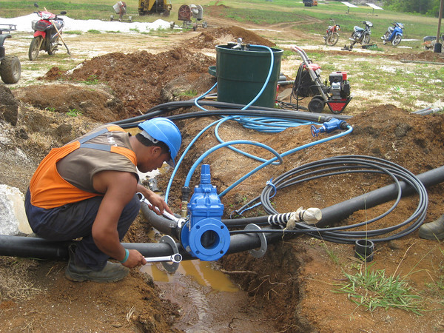
Te Mato Vai
Credit: New Zealand Ministry of Foreign Affairs & Trade
Solomon Islands PV Power Generation
Credit: New Zealand Ministry of Foreign Affairs & Trade

Slide 4
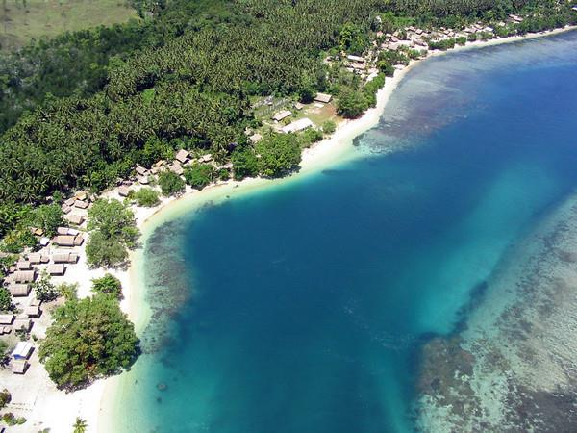
How can triangular cooperation be effective?
Empowering local stakeholders to enable the replication and improvement of technologies
Integrating hardware, software and orgware
Bringing in multiple stakeholders in different capacities
Coordinating technologies in cross-sectoral planning and policy formulation
Credit: New Zealand Ministry of Foreign Affairs & Trade
Reference: South–South cooperation and triangular cooperation on technologies for adaptation in the water and agriculture sectors, Technology Executive Committee, 2017, UNFCCC.

Slide 5
Presented by
Alysha Bagasra
UNFCCC Technology Executive Committee
New Zealand Ministry of Foreign Affairs & Trade
July 2018
Asia-Pacific Climate Week, Singapore

